Slide 1
Managing Projects Using Microsoft Project 2007

Slide 2
Agenda
Introductions
Setting Workshop Expectations
Project Management Concepts – (optional)
What’s New in Microsoft Project 2007
Introducing Microsoft Project 2007 Interface
Planning Projects With Microsoft Project 2007
Tasks ,Resources & Cost
Tracking
Views and Reports

Slide 3
Trainer Intro
Current: Business Consulting Head, AstroWix
Previous: Associate Vice President, Center of Excellence, STG
Experience: 10+ Years, 5+ in PM space.
Education: Bsc (Economics),Msc (Computer Science)
Certification: IBM and Microsoft Certified BI Solution Designer

Slide 4
Participants Intro
Your Name
Your Job
Your Company
Any prior PM training on concept/tool
What is your expectation from this class?

Slide 5
Project Management Concept

Slide 6
Benefits of Planning
Plan
Do / Undo / Redo
Start
Complete
Plan
Execute
Benefit of Planning
Start
Complete

Slide 7
Project-PMBOK® Definition
Project – A temporary endeavor undertaken to create a unique product or service
How Temporary?
Has a definite beginning and end, not an on-going effort
Ceases when objectives have been attained
Team is disbanded upon project completion
Unique?
Product characteristics are progressively elaborated
The product or service is different in some way from other product or services
Notes:
What is a Project
Organizations perform work. Work generally involves either operations or projects, although the two may overlap. Operations and projects share many characteristics; for example, they are: Performed by people. Constrained by limited resources. Planned, executed, and controlled.
Projects are often implemented as a means of achieving an organization’s strategic plan. Operations and projects differ primarily in that operations are ongoing and repetitive while projects are temporary and unique.
A project can thus be defined in terms of its distinctive characteristics—a project is a temporary endeavor undertaken to create a unique product or service. Temporary means that every project has a definite beginning and a definite end. Unique means that the product or service is different in some distinguishing way from all other products or services. For many organizations, projects are a means to respond to those requests that cannot be addressed within the organization’s normal operational limits.
Examples of projects include:
Developing a new product or service
Effecting a change in structure, staffing, or style of an organization
Designing a new transportation vehicle
Developing or acquiring a new or modified information system
Constructing a building or facility
Building a water system for a community in a developing country
Running a campaign for political office
Implementing a new business procedure or process
Temporary
Temporary means that every project has a definite beginning and a definite end. The end is reached when the project’s objectives have been achieved, or when it becomes clear that the project objectives will not or cannot be met, or the need for the project no longer exists and the project is terminated. Temporary does not necessarily mean short in duration; many projects last for several years. In every case, however, the duration of a project is finite; projects are not ongoing efforts.
Unique Product, Service, or Result
Projects involve doing something that has not been done before and which is, therefore, unique. A product or service may be unique even if the category to which it belongs is large. For example, many thousands of office buildings have been developed, but each individual facility is unique—different owner, different design, different location, different contractors, and so on. The presence of repetitive elements does not change the fundamental uniqueness of the project work.
For example:
A project to develop a new commercial airliner may require multiple prototypes
A project to bring a new drug to market may require thousands of doses of the drug to support clinical trials
A real estate development project may include hundreds of individual units
A development project (e.g., water and sanitation) may be implemented in five geographic areas
Progressive Elaboration
Progressive elaboration is a characteristic of projects that accompanies the concepts of temporary and unique. Progressive elaboration means developing in steps, and continuing by increments1. For example, the project scope will be broadly described early in the project and made more explicit and detailed as the project team develops a better and more complete understanding of the objectives and deliverables.

Slide 8
Triple Constraint Theorem
Time
Cost
Quality
Scope
Balancing SCOPE, COST and TIME within the frame work of QUALITY, meeting customer expectations
Harold Kerzner
Notes:
The triple constraints in project management refer to the scope, time, and cost constraint of any project.
The scope constraint details the project requirements against the existing need of the project versus the expectations.
The time constraint addresses the timing and length of the project.
The cost constraint defines the total cost of the project both operating and implementation costs.

Slide 9
What is Project Management?
The application of knowledge, skills, tools, and techniques to project activities in order to meet or exceed stakeholder needs and expectations
Stakeholder
Individuals and organizations involved in or affected by the project outcome

Slide 10


Project Manager’s Operating Environment
Government
Suppliers
The Organization
Organization Goals
Top Management
Sponsor
Boss
Project Manager
Project Staff
Colleagues
Managers Controlling Internal Resources
Internal Users
Sub Contractors
External Users

Slide 11
Process Interaction
Initiating Process
Planning Process
Execution Process
Closing Process
Controlling Process

Slide 12
Typical Project Life Cycle
Executing Processes
Planning Processes
Initiating Processes
Controlling Processes
PhaseStart
Time
Phase Finish

Slide 13
Related Endeavors
Program – Consists of a group of projects supporting broad, general goals and managed in a coordinated way
Subprojects – Components of a project that are often contracted out

Slide 14
Define & Organize the Project
Planning and Executing Projects
Define & Organize the Project
Establish the Project Organization
Define the Project Parameters
Plan the Project
Develop WBS
Develop the Schedule
Execute & Control the Project
Collect Status
Analyze Variance
Plan & Take Adaptive Action
Define the Project Framework
Refine Est. & Resource Req.
Develop Risk Management Plan
Report Project Status
Close Out
Formal Acceptance
Project Archive
Lessons Learned

Slide 15
Define & Organize the Project
Planning and Executing Projects
Define & Organize the Project
Establish the Project Organization
Define the Project Parameters
Plan the Project
Develop WBS
Develop the Schedule
Execute & Control the Project
Collect Status
Analyze Variance
Plan & Take Adaptive Action
Define the Project Framework
Refine Est. & Resource Req.
Develop Risk Management Plan
Report Project Status
Close Out
Formal Acceptance
Project Archive
Lessons Learned

Slide 16
Develop the Work Breakdown Structure
Define & Organize the Project
Plan the Project
Execute & Control the Project
Close Out
Develop WBS
Break the Project Down
Assign Ownership
Document Completion Criteria

Slide 17
Work Breakdown Structure (WBS)
Define & Organize the Project
Plan the Project
Execute & Control the Project
Close Out
A
A1
A2
A3
A1.1
WBS is a tool for identifying project work
Hierarchical, logical structuring of project work
It provides comprehensive Methodology

Slide 18
WBS Decomposition
Define & Organize the Project
Plan the Project
Execute & Control the Project
Close Out
Team should be involved to:
Identify 4-7 major components of work (how you will manage work)
Identify Level 2 tasks for each grouping
Repeat the process until a task has:
- One owner (may be multiple doers)
- Clear deliverable
- 2-20 days duration
- Credible estimate of duration
- Ability to be tracked
A
A1
A2
A3
A1.1

Slide 19
Remember in include
Define & Organize the Project
Plan the Project
Execute & Control the Project
Close Out
!
Task related with following:
Planning activities for the project
Approval cycle
Key project meetings
Management/customer interfaces
Quality inspections/fixing defects
Training
Project management
Test planning, development and execution
Project reviews and project closing

Slide 20
WBS- Bottom-up
Define & Organize the Project
Plan the Project
Execute & Control the Project
Close Out
Team Effort:
Brainstorm all tasks
Organize tasks into 4-7 major groupings reflecting how the project will be managed

Slide 21

Level of Detail
Define & Organize the Project
Plan the Project
Execute & Control the Project
Close Out
Project is broken down to the level of desired tracking

Slide 22
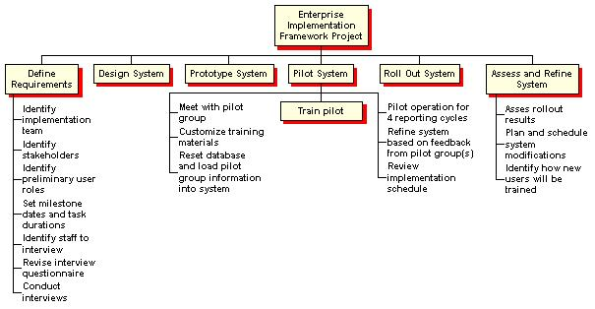
WBS Example
Define & Organize the Project
Plan the Project
Execute & Control the Project
Close Out

Slide 23
Assign Ownership
Define & Organize the Project
Plan the Project
Execute & Control the Project
Close Out
Task Ownership
Multiple Owners = 0 owners
1 owner per task
Owner responsible for planning and managing task
Owner may or may not be a doer

Slide 24
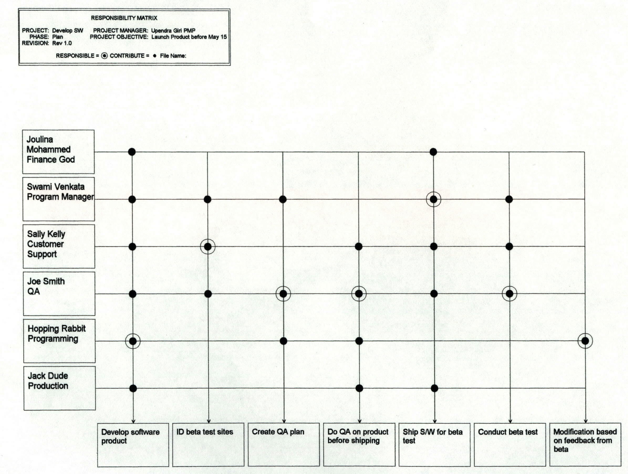
Responsibility Matrix
Define & Organize the Project
Plan the Project
Execute & Control the Project
Close Out

Slide 25
Develop The Preliminary Schedule
Define & Organize the Project
Plan the Project
Execute & Control the Project
Close Out
Develop the Schedule
Determining Logical Dependency
Approximate Duration
Analyze Network

Slide 26
Network Development
Define & Organize the Project
Plan the Project
Execute & Control the Project
Close Out
Precedence Diagramming Method
A
B
C
Start
Finish
Activity on Node
D
E
F

Slide 27
Milestones
Define & Organize the Project
Plan the Project
Execute & Control the Project
Close Out
No Duration or Work
Start/Finish
Significant Events (Example- Conference)
External dependencies/ deliverables
Major Accomplishments
Phase Signoffs
Intermediate Checkpoints
Status reporting periods

Slide 28
Network Development
Define & Organize the Project
Plan the Project
Execute & Control the Project
Close Out
Task Relationships
Predecessor
i
Finish to Start
Successor
j i
Predecessor
Successor
j
i
j
i
j
Start to Finish
Predecessor
Successor
Finish to Finish
Predecessor
Start to Start
Successor

Slide 29
Network Development
Define & Organize the Project
Plan the Project
Execute & Control the Project
Close Out
Task Relationships – Lead & Lag
Predecessor
Finish to Start
i
lag
Successor
2d
j
Predecessor
i
lead
Finish to Start
2d
Successor
j

Slide 30
Precedence Diagram
Define & Organize the Project
Plan the Project
Execute & Control the Project
Close Out
ES EF
ES EF
ES EF
Duration 7 Task A
Duration 6 Task C
Duration 3 Task G
LS LF
LS LF
ES EF
LS LF
Duration 2 Task H
Start
Finish
ES EF
ES EF
ES EF
LS LF
Duration 3 Task B
Duration 3 Task D
Duration 3 Task E
LS LF
LS LF
LS LF
ES EF
Duration 2 Task F
LS LF

Slide 31
Forward Pass – Early Start, Early Finish
ES EF
ES EF
ES EF
Duration 7 Task A
0
7
Duration 3 Task G
Duration 6 Task C
13
16
7
13
LS LF
LS LF
ES EF
LS LF
Duration 2 Task H
16
18
Start
Finish
ES EF
ES EF
ES EF
LS LF
Duration 3 Task B
0
3
Duration 3 Task D
3
6
Duration 3 Task E
6
9
LS LF
LS LF
LS LF
ES EF
Duration 2 Task F
3
5
LS LF

Slide 32
Backward Pass – Late Start, Late Finish
0
0
0
ES EF
ES EF
ES EF
Duration 7 Task A
0
7
Duration 3 Task G
Duration 6 Task C
13
16
7
13
0
7
7
13
13
16
0
LS LF
LS LF
ES EF
LS LF
Duration 2 Task H
16
18
Start
Finish
7
7
7
16
18
ES EF
ES EF
ES EF
LS LF
Duration 3 Task B
0
3
Duration 3 Task D
3
6
Duration 3 Task E
6
9
7
10
10
13
13
16
LS LF
LS LF
LS LF
8
ES EF
Duration 2 Task F
3
5
11
13
LS LF

Slide 33
Critical Path – Longest Path, Zero Float
0
0
0
ES EF
ES EF
ES EF
Duration 7 Task A
0
7
Duration 3 Task G
Duration 6 Task C
13
16
7
13
0
7
7
13
13
16
0
LS LF
LS LF
ES EF
LS LF
Duration 2 Task H
16
18
Start
Finish
7
7
7
16
18
ES EF
ES EF
ES EF
LS LF
Duration 3 Task B
0
3
Duration 3 Task D
3
6
Duration 3 Task E
6
9
7
10
10
13
13
16
LS LF
LS LF
LS LF
8
ES EF
Duration 2 Task F
3
5
11
13
LS LF

Slide 34
Critical Path : Longest Path Zero Float
Define & Organize the Project
Plan the Project
Execute & Control the Project
Close Out
Forward Pass = Early Start/Finish
Backward Pass = Late Start/Finish
Positive Float/Negative Float
Critical Path has zero or negative float

Slide 35
Exercise - Critical Path
Define & Organize the Project
Plan the Project
Execute & Control the Project
Close Out
ES EF
ES EF
ES EF
Duration 4 Task A
Duration 4 Task B
Duration 3 Task C
LS LF
LS LF
LS LF
ES EF
ES EF
Duration 10 Task G
Start
Duration 7 Task D
Finish
LS LF
ES EF
LS LF
ES EF
Duration 5 Task E
Duration 5 Task F
LS LF
LS LF

Slide 36
Approve & Set the Project Baseline Plan
Define & Organize the Project
Plan the Project
Execute & Control the Project
Close Out
Baseline
Snapshots of approved plan
Establishes a target
Provides something to measure progress against
Makes project goals visible

Slide 37
Approve & Set the Project Baseline Plan
Define & Organize the Project
Plan the Project
Execute & Control the Project
Close Out
Definition
The baseline is the plan against which all project progress will be measured
The baseline is set at the end of the planning phase

Slide 38
Approve & Set the Project Baseline Plan
Define & Organize the Project
Plan the Project
Execute & Control the Project
Close Out
Process
Communicate the setting of the baseline to all groups that are impacted
Distribute approved plans and supporting assumptions in accordance with project framework decisions
Archive a copy of the schedule and resource plans along with the assumptions
Ensure that any contracts with suppliers and customers are consistent with the baseline

Slide 39
Approve & Set the Project Baseline Plan
Define & Organize the Project
Plan the Project
Execute & Control the Project
Close Out
Changing the Baseline
Once set, it should not be easily changed
The baseline plan can only be changed after:
Major events which cause change have been identified and communicated
Impact of changes has been approved

Slide 40
Define & Organize the Project
Planning and Executing Projects
Define & Organize the Project
Establish the Project Organization
Define the Project Parameters
Plan the Project
Develop WBS
Develop the Schedule
Execute & Control the Project
Collect Status
Analyze Variance
Plan & Take Adaptive Action
Define the Project Framework
Refine Est. & Resource Req.
Develop Risk Management Plan
Report Project Status
Close Out
Formal Acceptance
Project Archive
Lessons Learned

Slide 41
Define & Organize the Project
Planning and Executing Projects
Define & Organize the Project
Establish the Project Organization
Define the Project Parameters
Plan the Project
Develop WBS
Develop the Schedule
Execute & Control the Project
Collect Status
Analyze Variance
Plan & Take Adaptive Action
Define the Project Framework
Refine Est. & Resource Req.
Develop Risk Management Plan
Report Project Status
Close Out
Formal Acceptance
Project Archive
Lessons Learned

Slide 42
Track & Manage the Project
Define & Organize the Project
Plan the Project
Execute & Control the Project
Close Out
Benefits of Tracking
Provides clear indication of progress
Keeps everyone informed
Encourages the addressing of problems
Provides credible completion estimates

Slide 43
Data Collection
Define & Organize the Project
Plan the Project
Execute & Control the Project
Close Out
3 Key Questions
Did the task start?
If yes, on what date?
What date will the task finish?
If finishes on what date did it finish?
2-3 week window
Usually less than 15 tasks per status period
Low-key, unintrusive status collection!

Slide 44
Status Collection Methods
Define & Organize the Project
Plan the Project
Execute & Control the Project
Close Out
Reports
Meeting
Planning Support
E-Mail

Slide 45
Identify Variances
Define & Organize the Project
Plan the Project
Execute & Control the Project
Close Out
Variances is the difference between plan and actual
Projects slip one day at a time

Slide 46
Identify Variances
Define & Organize the Project
Plan the Project
Execute & Control the Project
Close Out
Schedule
Variances
New activities on the critical path
Changes in milestone dates or the end date of the project
Reductions or increases in float for upcoming activities
Slips in the schedule of particular groups of activities

Slide 47
Identify Variances
Define & Organize the Project
Plan the Project
Execute & Control the Project
Close Out
Resource
Variance
Investments of more time than planned
Not investing enough time to get the task done on schedule
Conflicting requirements for common resources (now and in the future)

Slide 48
Identify Variances
Define & Organize the Project
Plan the Project
Execute & Control the Project
Close Out
Scope
Variance
Deliverables not meeting or exceeding specs
Deliverables not meeting or exceeding quality requirements

Slide 49
Earned Value – Variance Analysis
Schedule Variance:
SV = EV – PV (or BCWP-BCWS)
Cost Variance:
CV = EV-AC (or BCWP-ACWP)
Schedule Performance Index:
SPI = EV/PV (or BCWP/BCWS)
Cost Performance Index:
CPI = EV/AC (or BCWP/ACWP)

Slide 50
Save Status Information
Define & Organize the Project
Plan the Project
Execute & Control the Project
Close Out
Purpose
Provides new team members or new project manager taking over an ongoing project with valuable information
Summarizes adaptive actions taken to date

Slide 51
Define & Organize the Project
Planning and Executing Projects
Define & Organize the Project
Establish the Project Organization
Define the Project Parameters
Plan the Project
Develop WBS
Develop the Schedule
Execute & Control the Project
Collect Status
Analyze Variance
Plan & Take Adaptive Action
Define the Project Framework
Refine Est. & Resource Req.
Develop Risk Management Plan
Report Project Status
Close Out
Formal Acceptance
Project Archive
Lessons Learned

Slide 52
Define & Organize the Project
Planning and Executing Projects
Define & Organize the Project
Establish the Project Organization
Define the Project Parameters
Plan the Project
Develop WBS
Develop the Schedule
Execute & Control the Project
Collect Status
Analyze Variance
Plan & Take Adaptive Action
Define the Project Framework
Refine Est. & Resource Req.
Develop Risk Management Plan
Report Project Status
Close Out
Formal Acceptance
Project Archive
Lessons Learned

Slide 53
Conduct a Closeout Review
Define & Organize the Project
Plan the Project
Execute & Control the Project
Close Out
Purpose
A close out review should highlight both what went right and what went wrong
Both are essential for continuous improvement
Exploit the successes and identify the elements which contributed to the success
Avoid the problems in the future and identify processes that need to be defined, redefined and improved
Key Learning's can be valuable for the next project

Slide 54
Close the Project File
Define & Organize the Project
Plan the Project
Execute & Control the Project
Close Out
Process
Complete all final review documents
Bundle similar reports, if possible (all status reports) and label the bundle
Facilitates later research
Helps ensure that individual; papers aren’t lost
All files should be sent to Administration for storage
Ensuring that the files are stored properly and is the project managers responsibility

Slide 55
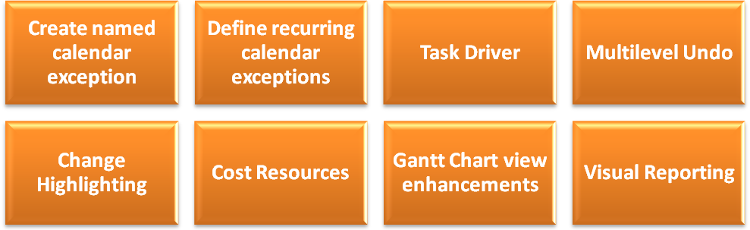
What’s new in Microsoft Project 2007

Slide 56
Introducing Microsoft Project 2007 Interface

Slide 57
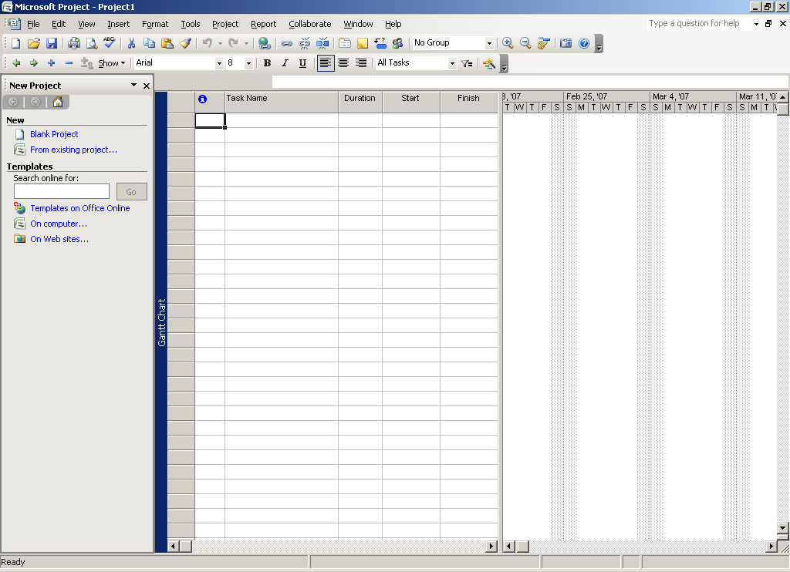
Format Tool Bar
Project 2007 Interface
Standard Tool Bar
Gant Chart
Project Guide

Slide 58
The Standard Toolbar
Project 2007 Interface
Task Drivers
Scroll Task
Save
Print Preview
Paste
Insert Hyperlink
Unlink Task
Task Information
New
Cut
Undo
Zoom In
Help
Open
Spelling
Format Painter
Link Task
Task Note
Zoom Out
Print
Copy
Redo
Split Link
Assign Resources
Copy Picture

Slide 59
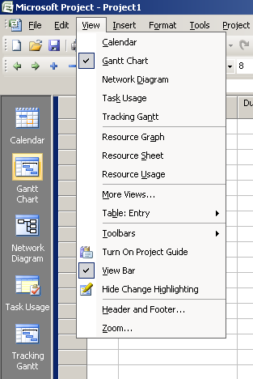
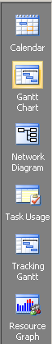
View Bar
Project 2007 Interface
Button is described for the Active View
View Name is not displayed on the border when the view bar is visible
Toggles the display state of the view bar

Slide 60
Exercise

Slide 61
Project Plan Example - Software Development
ID | Task Name | Durations | Resources | Task Relationship
1 | Requirement Study | 4 days | Systems Analyst – 1No.
2 | Design
3 | High level design | 3 days | Designer – 1No. | 1 FS
4 | Low level design
5 | Module-1 | 4 days | Designer – 1 No. | 3 FS
6 | Module-2 | 5 days | Designer – 1 No. | 5 SS
7 | Development
8 | Module-1 | 12 days | Programmer – 1 No. | 5 FS
9 | Module-2 | 18 days | Programmer – 1 No. | 6 FS
10 | Testing
11 | Unit-1 | 4 days | QA Engineer – 1 No. | 8 FS
12 | Unit-2 | 6 days | QA Engineer – 1 No. | 9 FS
13 | Integration | 4 days | QA Engineer – 1 No. | 11 FS, 12 FS
14 | Software Documentation | 20 days | Technical Writer – 1 No. | 13 FF
15 | Release Software | 0 days |  | 13 FS, 14 FS
Resources | Max. Units | Std. Rate | Cost/Use
System Analyst | 1 No. | $ 50 | $ 50
Designer | 1 No. | $ 30 | $ 30
Programmer | 2 No. | $ 20 | $ 20
QA Engineer | 1 No. | $ 30 | $ 30
Technical Writer | 1 No. | $ 10 | $ 10

